Slide 1

Credit Card Fraud Detection
DSC 680
Marc Riley

Slide 2

contents
Problem Statement
Data Source
EDA
Model
Results
Limitations
Ethical Concerns

Slide 3
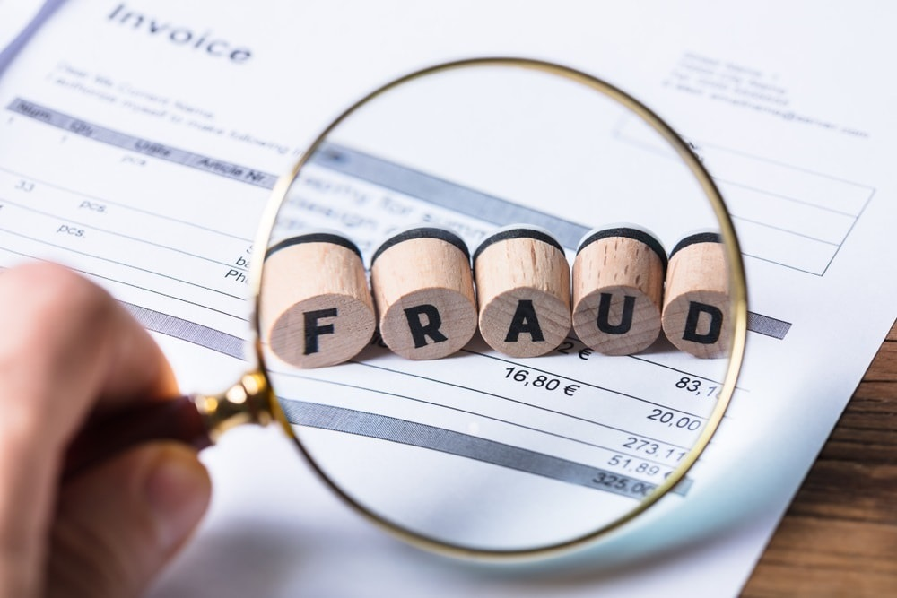
Introduction
Credit card fraud is a considered a type of identity theft that occurs when an unauthorized user makes a transaction (Mint, 2021). Many individuals and corporations struggle with this problem.

Slide 4
Data Source
Data was provided by Kaggle.com
Over 280,000 Transactions
492 of these are fraudulent
Target variable is fraud “Y or N”
Over 28 different variables such as
Most variables have been given a different name to protect sensitive data

Slide 5
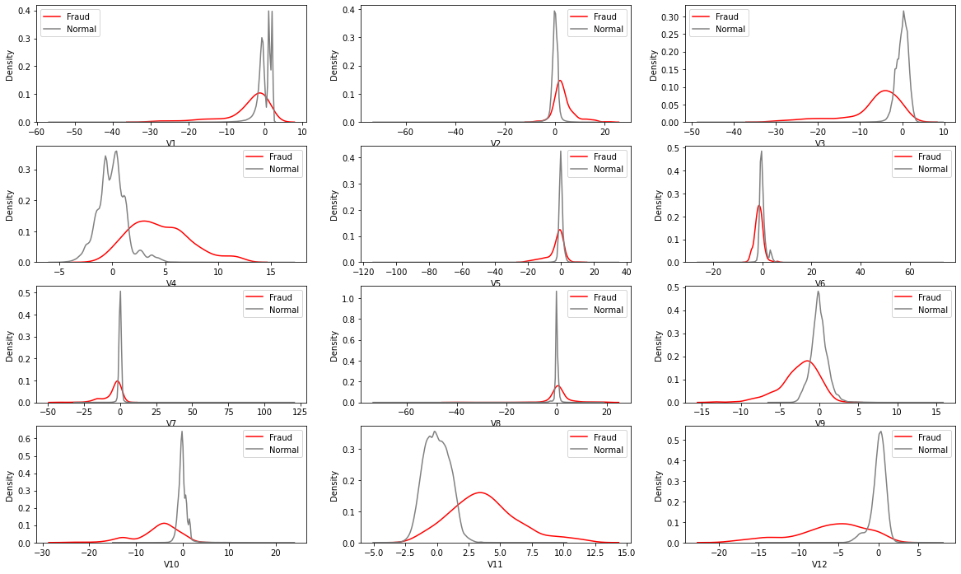
Data Analysis

Slide 6
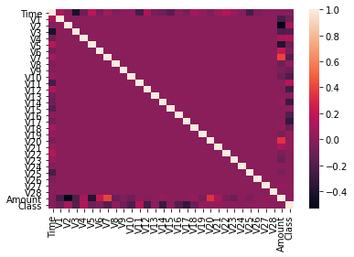
DATA Analysis
Detection of Duplicates /Missing Values
Correlation Test
1081 Duplicates
30 were positive cases
No missing values

Slide 7
EDA Overview
Correlation test ran all variables were kept
Duplicates were left in
Missing Values were not present in this data set
Outliers were kept in

Slide 8
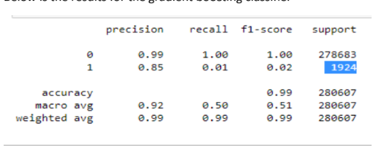
Model
Model
Gradient Boosting Classifier
Group of algorithms
Multiple decision trees
Can be sensitive to outliers
Results

Slide 9
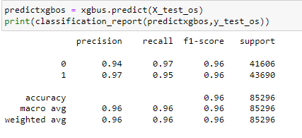
Improved Model/conclusion
Over Sampling using SMOTE
Synthetic samples are generated
Evens classes out
Can oversample or under sample
Results

Slide 10
Ethical Considerations
Some groups can be at risk of higher rates or loss of service depending on the results
False negatives/positives could potentially affect individuals

Slide 11
Resources
https://towardsdatascience.com/oversampling-and-undersampling-5e2bbaf56dcf
https://corporatefinanceinstitute.com/resources/knowledge/other/boosting/
https://stats.stackexchange.com/questions/234016/opinions-about-oversampling-in-general-and-the-smote-algorithm-in-particular
https://www.kaggle.com/mlg-ulb/creditcardfraud

